Slide 1
Medical Insurance Cost with regression models

Slide 2
OUR Group
Group 02
Rohan Aryan-C0912902
Binaya Kumar Chaudhary-C0913554
Hemant Raj Singh- C0904955
Saniasnain Mulla-C0906772
Shreya Boral- C0913115

Slide 3
CONTENTS OF THIS Presentation
Business Case Understanding (Use Case analysis)
Data identification
Data Extraction
Data Validation and Cleansing
Data Analysis
Utilization of analysis results
References

Slide 4
01
Business Case Understanding
(Use Case analysis)

Slide 5
Use Case Analysis: Predictive Insurance Cost Model
Purpose: Develop a model to predict insurance costs based on BMI, Sex, Smoking, Region, Age, and Children.
Benefits for Insurance Companies: Accurate risk assessment, precise policy pricing, customer segmentation, streamlined underwriting, and effective market strategies.
Use Case Example: 35-year-old non-smoking female with a BMI of 25, suburban region, two children - precise premium estimation.
User Benefits: Easy for individuals, transparent cost estimates, and data-driven precision.
Mutual Benefits: Improved fairness, competitive pricing, better customer service, operational efficiency.

Slide 6
02
Data identification

Slide 7
Features
age: age of primary beneficiary
sex: insurance contractor gender, female, male
bmi: Body mass index, providing an understanding of body, weights that are relatively high or low relative to height, objective index of body weight (kg / m ^ 2) using the ratio of height to weight, ideally 18.5 to 24.9
children: Number of children covered by health insurance / Number of dependents
smoker: Smoking
region: the beneficiary's residential area in the US, northeast, southeast, southwest, northwest

Slide 8
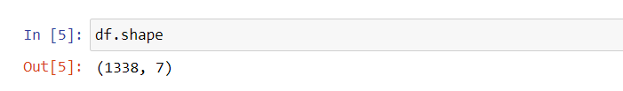
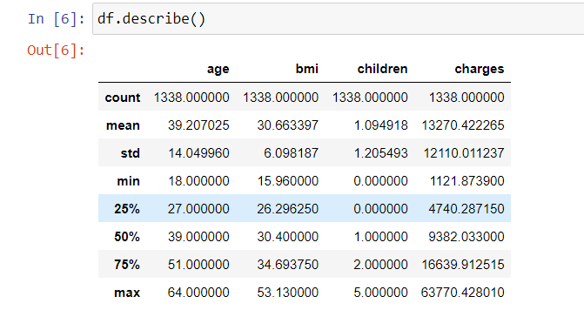
Dataset description
Shape of the data set:
Description:

Slide 9
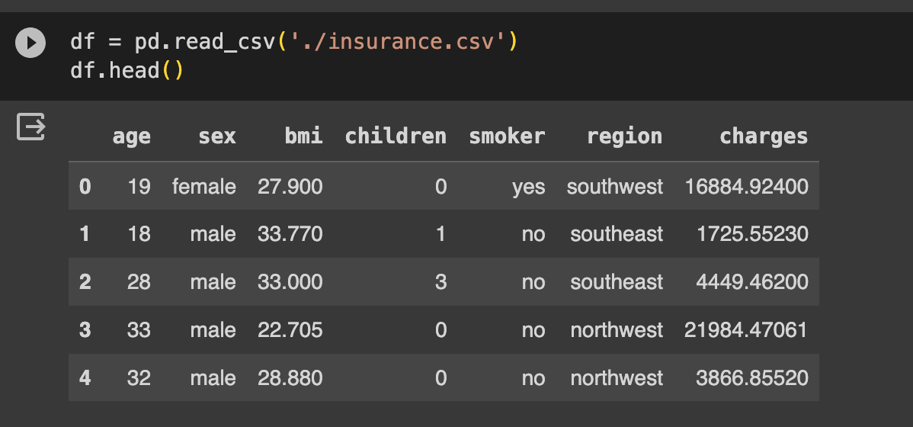
Sample data
Here is a snapshot of how the data set looks like:

Slide 10
03
Data Extraction

Slide 11
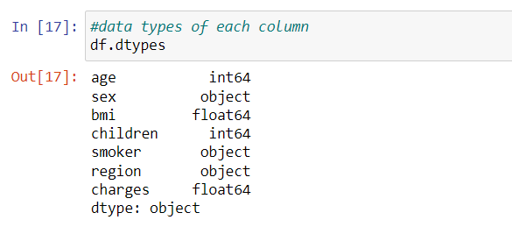
Data extraction
Data types:
The data identified may not always be compatible with the solution. The goal of this phase is to transform the data that can be accepted by the solution (model) for accurate and high quality outputs.
The data types of each column are as shown in the snapshot.
Here we noticed that sex, smoker and region columns are of object type.

Slide 12
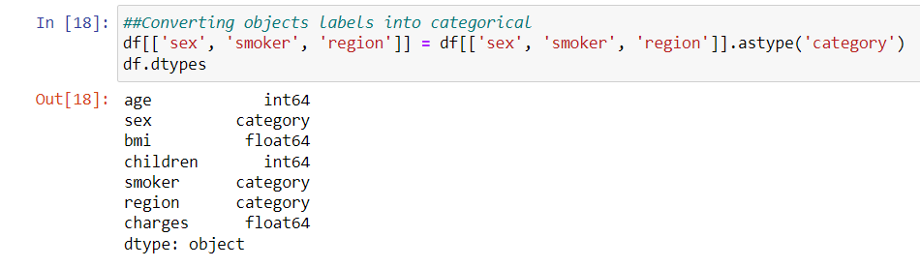
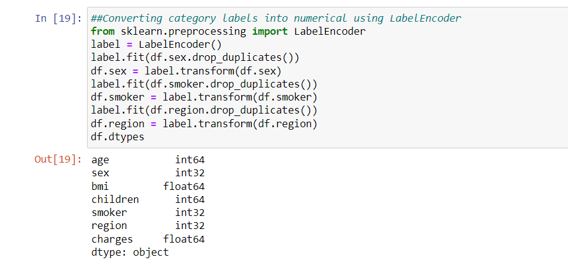
Data extraction: label encoding
Regression models only work with numeric data, categorical or text data does not have a natural numeric representation.
Converting data type to category Category to label encoding

Slide 13
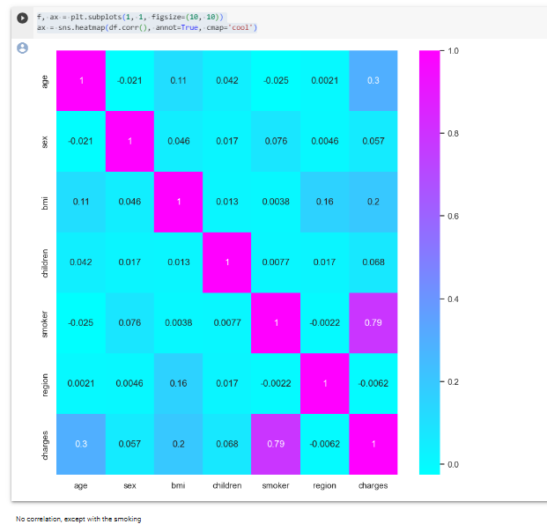
Finding correlation
We used a heatmap to understand the correlation
Between the columns and by observing the plot we can conclude that there is no correlation of others except for smoking with respect to charges.

Slide 14
04
Data Validation and Cleansing

Slide 15
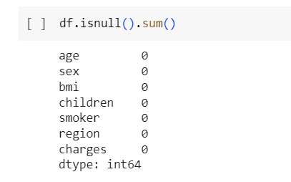
Data validation: checking for nulls
The data being used for this model building is purely valid and does not require any complex validation rules to eradicate corrupt data.

Slide 16
05
Data Analysis

Slide 17
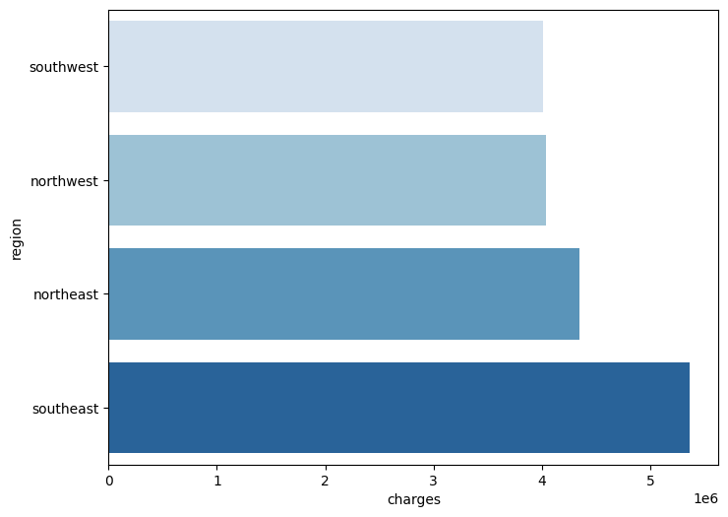
Analysing charges by region

Slide 18
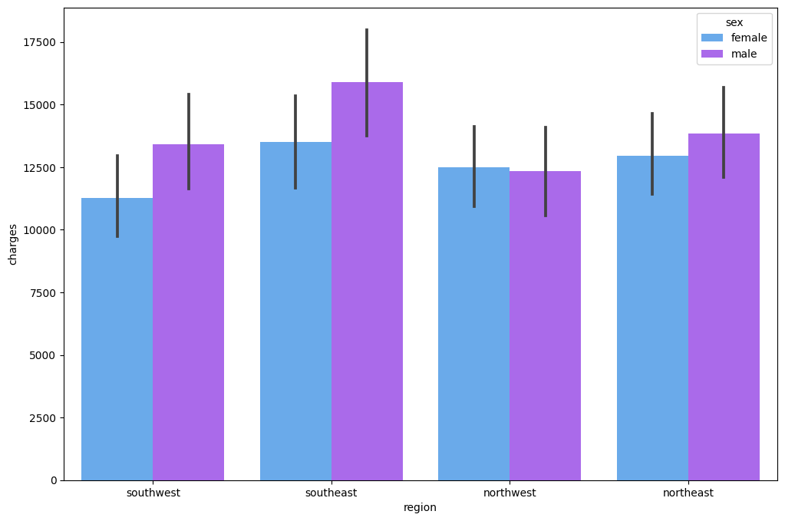
Analysing charges by region and gender

Slide 19
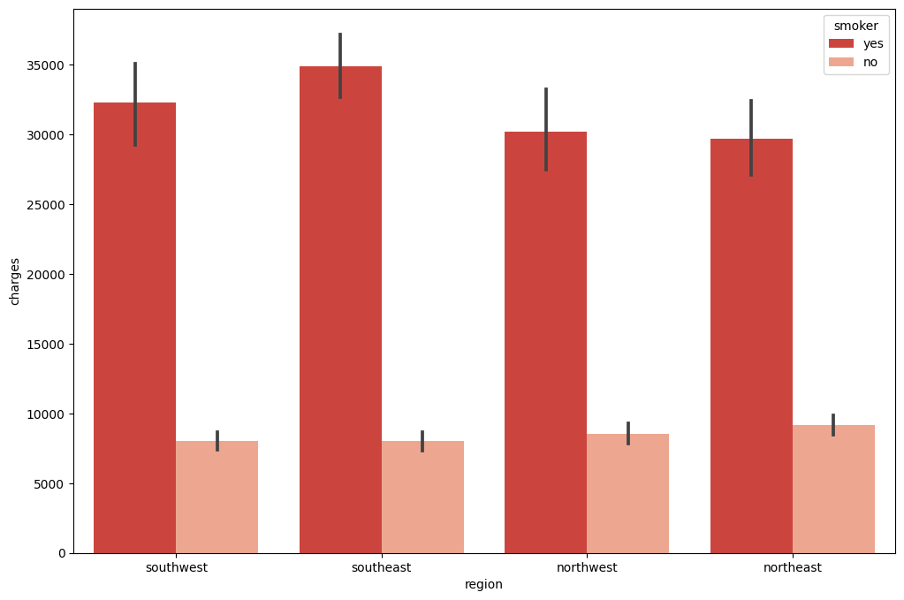
Analysing charges based on smoking

Slide 20
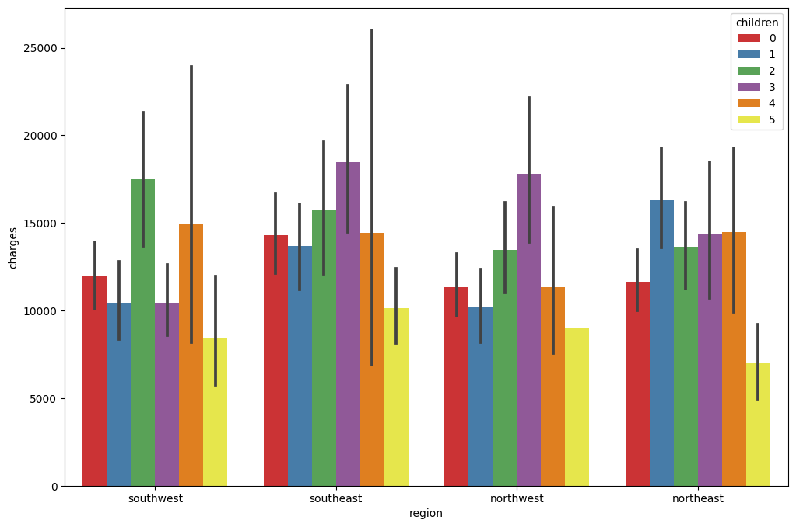
Analysing charges by number of children

Slide 21
06
Utilization of analysis results

Slide 22
Linear Regression
The first algorithm used was linear regression.
We split the data set into test and train data in a 2:8 ratio
We then fed the data to the model and calculated the score of the fit (Performance of the model) and the Mean Absolute Error (MAE)
We got a performance of 79% which was not good enough so we chose a different approach.

Slide 23

Linear regression
Performance we got with Linear regression model
We got a r-squared of 79% and MAE is 3930.33

Slide 24
Polynomial regression
The second model we used
We used second-degree polynomial regression model.
After looking at the feature importance visualization, we dropped columns that did correlated with the target value.
The original features (x) were transformed into polynomial features.
We split the data set into test and train data in a 2:8 ratio

Slide 25

Polynomial regression
Performance we got with Polynomial regression model
We got a r-squared of 88% and MAE is 2824.49

Slide 26
References
https://pandas.pydata.org/docs/index.html
https://numpy.org/
https://seaborn.pydata.org/index.html
https://matplotlib.org/
https://scikit-learn.org/stable/index.html
https://www.kaggle.com/datasets/mirichoi0218/insurance
https://towardsdatascience.com/introduction-to-linear-regression-and-polynomial-regression-f8adc96f31cb

